Slide 1
Comparative Social Media Analytics of Telecommunication GiffGaff and iDMobile
CIS7029 - Social Media Analytics for Business
Aaditya Vengatachalapathy
st20290358

Slide 2
Biography
As an independent Data Analyst of an upcoming Telecommunication companies from Section J , my role in this project is to analyse the data of two different mobile networks within the telecommunication market. As an analyst I’m going to compare two top competitors of mobile network i.e., GiffGaff and iDMobile. In this project I’m going to retrieve and gather social media data of both the competitor using different tools and techniques, then organize it in a meaningful charts and graphs and then use these graphs and charts to find some meaningful conclusion .

Slide 3
Abstract
(Purpose, Methodology)
This abstract compares user engagement, sentiment, and brand perception between idmobile and giffgaff using social media analytics. The research provides information about customer interactions, satisfaction levels, and competitive positioning in the telecom sector through the use of data mining tools. The outcomes help both businesses make strategic decisions that will improve their market competitiveness and customer experience.
I use a variety of techniques and tools—which I select from a large selection—when conducting research. Certain tools are used to retrieve Facebook and Youtube data, such as likes, comments, and likes, from the official pages of GiffGaff and iDMobile. Using Data Miner, SharedCount web tool and Python code is used to collect information such as likes shares and comments from Facebook , Trustpilot and YouTube channel information. The retrieved data is analysed using visualisation tools like Tableau and data sources like Excel. There are also some Google Chrome extensions in use. Azure Machine Learning (add-ins) in Excel and the Youtube API are used in a method for evaluating the sentiments of comments on YouTube.

Slide 4
Design
and
Discussion
The largest and most active data set in the modern era is social media data. Data from social media platforms is the new tool for studying human behaviour. Scientists and programmers are discovering and assessing many ways of automatically gathering, merging, and analysing the data in this advanced generation, where technology is the key to practically every sort of employment (Batrinca and Treleaven, 2014). This article uses a range of tools, techniques, and API for data collection and analysis. Let's take a quick look at the instruments used:

Slide 5
Data Miner and Scraper
Microsoft
Excel
An extension for Google Chrome called Data Miner and Scraper enables users to take information from websites and store it in Excel spreadsheets. In essence, it converts unstructured HTML data into a tabular form that is structured (Data Miner, n.d.; chrome.google.com, n.d.). In this study, the Facebook Comments, Likes, and List of Missions from Wikipedia are extracted using both Data Miner and Scraper.
Spreadsheets in Excel are the most widely utilised format, utilised by nearly all sizes of enterprises. A data analyst finds it very helpful to perform some simple math operations. We can format, filter, and sort the data as data analysts. Excel can also be used to create tables and charts (Excel-easy.com, 2010). I've been using Excel as a data source for this research, saving the scraped data for cleaning and using the cleaned data for visualisation.

Slide 6
Youtube API
Azure Machine Learning
Semantic-Analyzer
By giving developers access to YouTube's enormous library of videos, channels, and playlists, the YouTube API makes it possible to integrate YouTube with websites and applications. By incorporating functionalities like content posting, analytics retrieval, and video search, developers can personalise their platforms and improve user experiences.
Users can gain insights from unstructured text data by doing semantic analysis right within Excel with the Azure Machine Learning add-ins for Excel. Without leaving the comfortable Excel environment, users can make data-driven decisions and obtain deeper knowledge with features like sentiment analysis and keyword extraction.

Slide 7
Tableau
Google Colab
Tableau is an interactive application for data visualisation that lets you make appropriate and engaging dashboards and worksheets to get business insights for better development. It makes it simple for non-technical people to build personalised dashboards that offer insight into a wide range of data (Tableau, n.d.). I used Tableau to visualise the data into appropriate charts and graphs for my research paper. I've used treemaps for YouTube, packed bubble for Twitter, and side-by-side bars to compare the social media followings of the two stations.
Google Colab is a cloud-based tool that lets people write and run Python code together by giving them free access to Jupyter notebooks and computational resources. Colab's integrated machine learning frameworks and libraries make it simple and effective to conduct research, analyse data, and carry out educational projects.

Slide 8
Shared Count
A online service called SharedCount was created to give people information about how well their material performs on social networking. Users can obtain information on the number of times content has been shared on other platforms, such as Facebook, Twitter, Pinterest, and others, by inputting a URL. SharedCount provides insightful analytics that enable customers to monitor the impact and reach of their online presence.

Slide 9
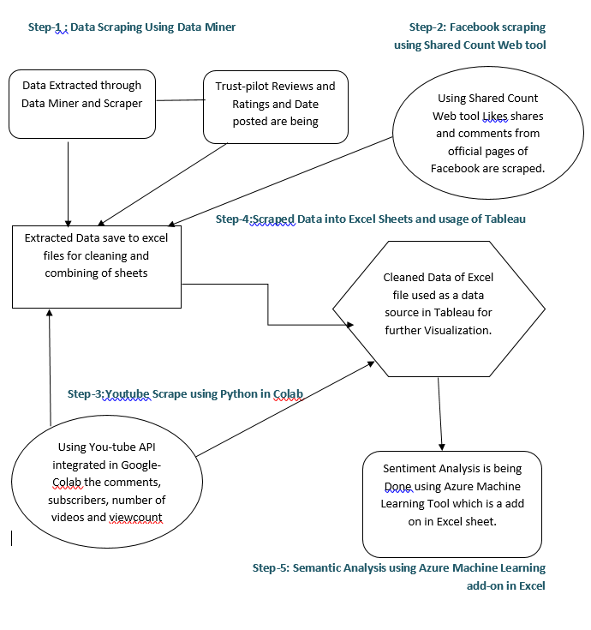
Workflow

Slide 10
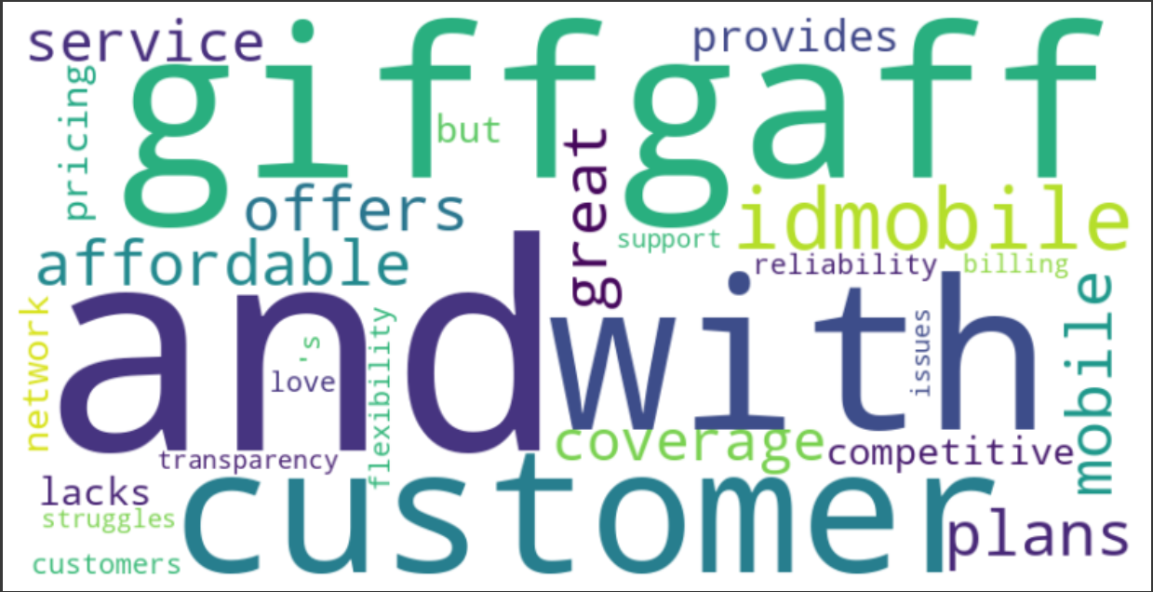
Word-Cloud

Slide 11
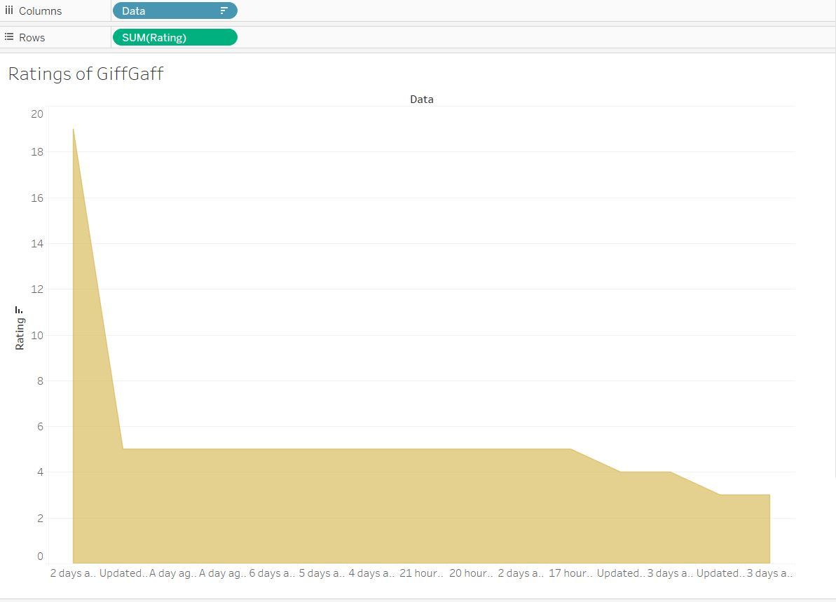
Visualisation on Ratings of GiffGaff

Slide 12
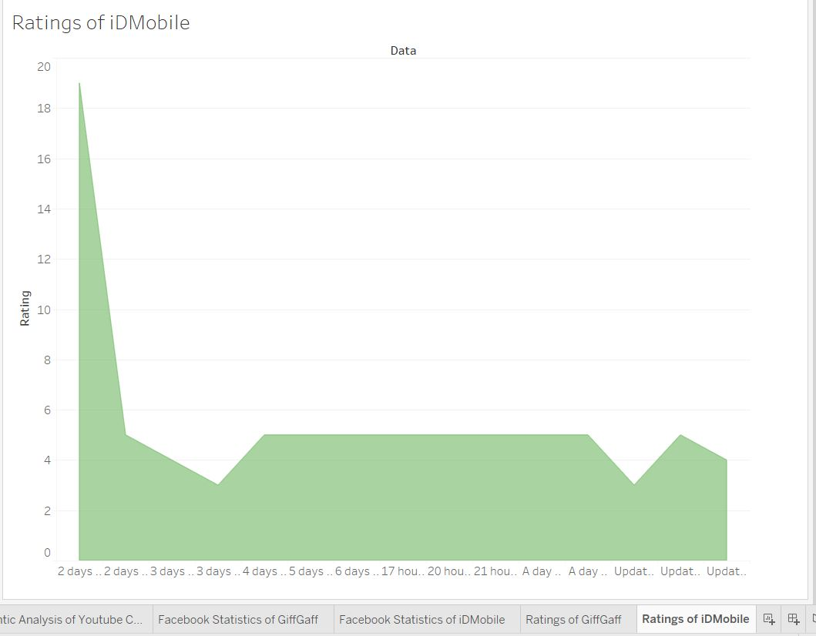
Visualisation on Ratings of iDMobile

Slide 13
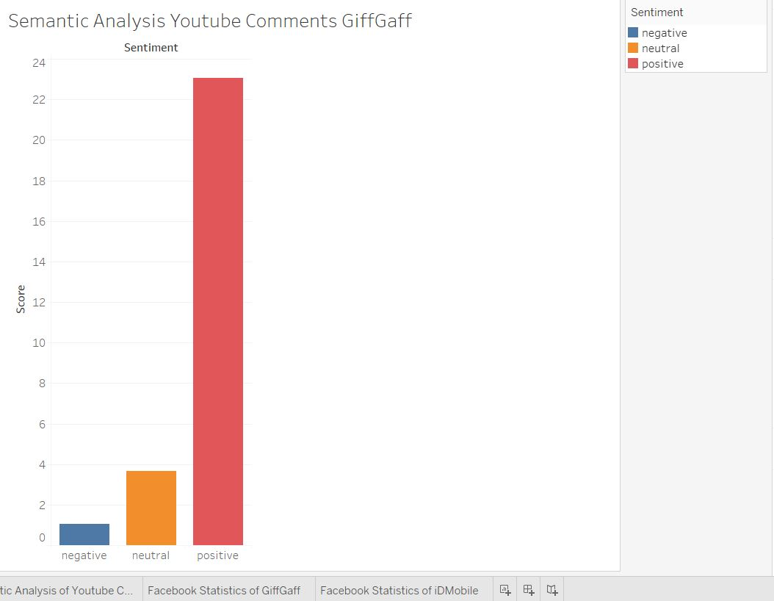
Visualisation of Semantic Analysis on GiffGaff

Slide 14
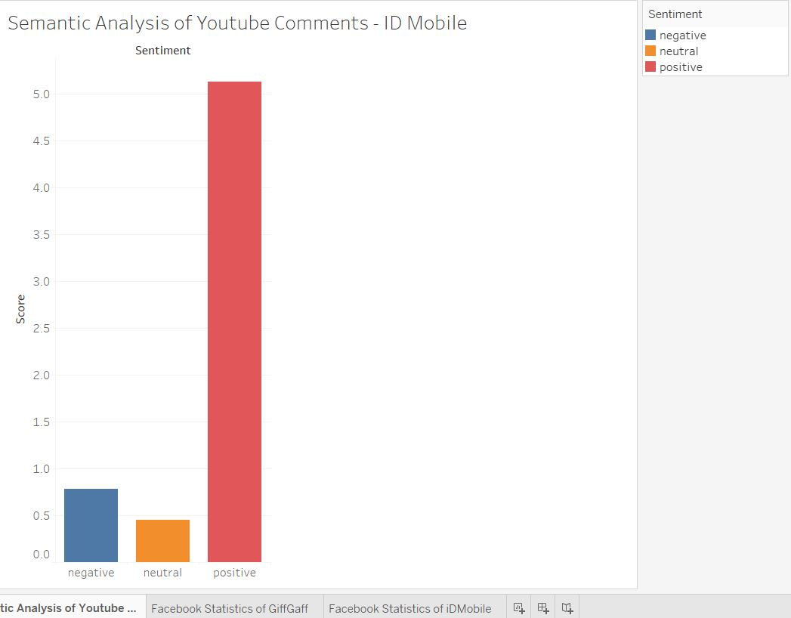
Visualisation of Semantic Analysis on iDMobile

Slide 15
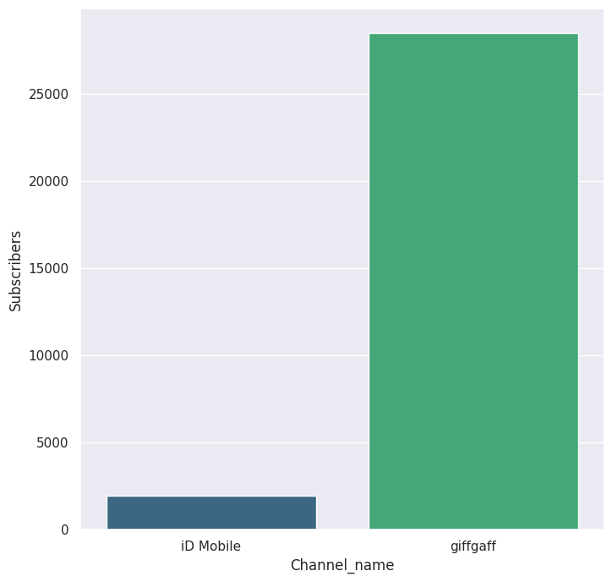
Visualisation of Youtube Comparison of GiffGaff and iDMobile - Subscribers difference

Slide 16
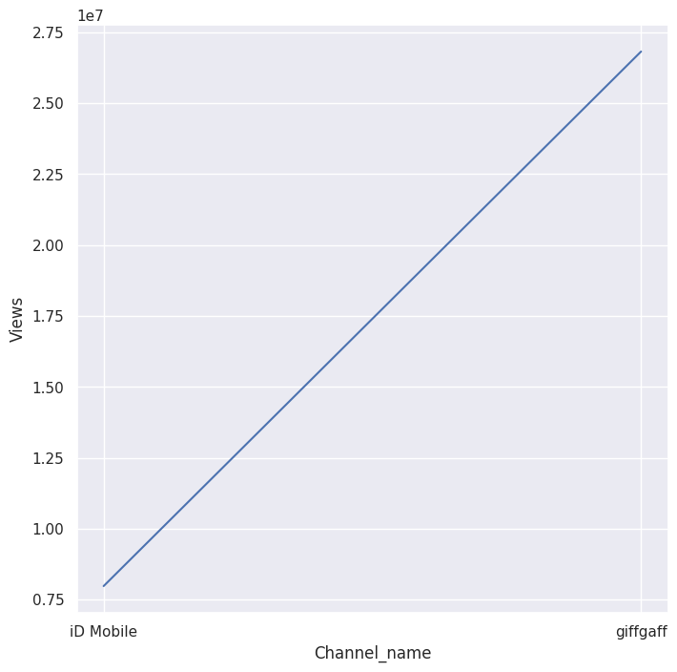
Visualisation of Youtube Comparison of GiffGaff and iDMobile - ViewsCount difference

Slide 17
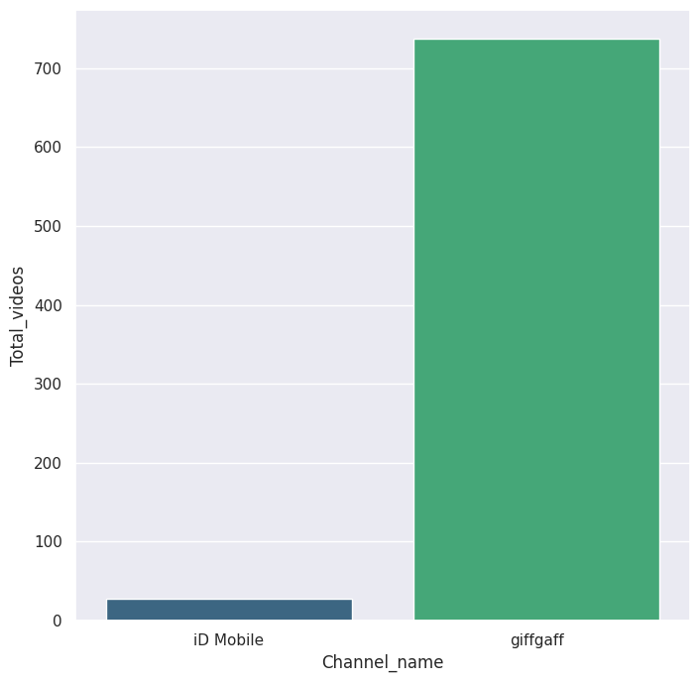
Visualisation of Youtube Comparison of GiffGaff and iDMobile - Videos published difference

Slide 18
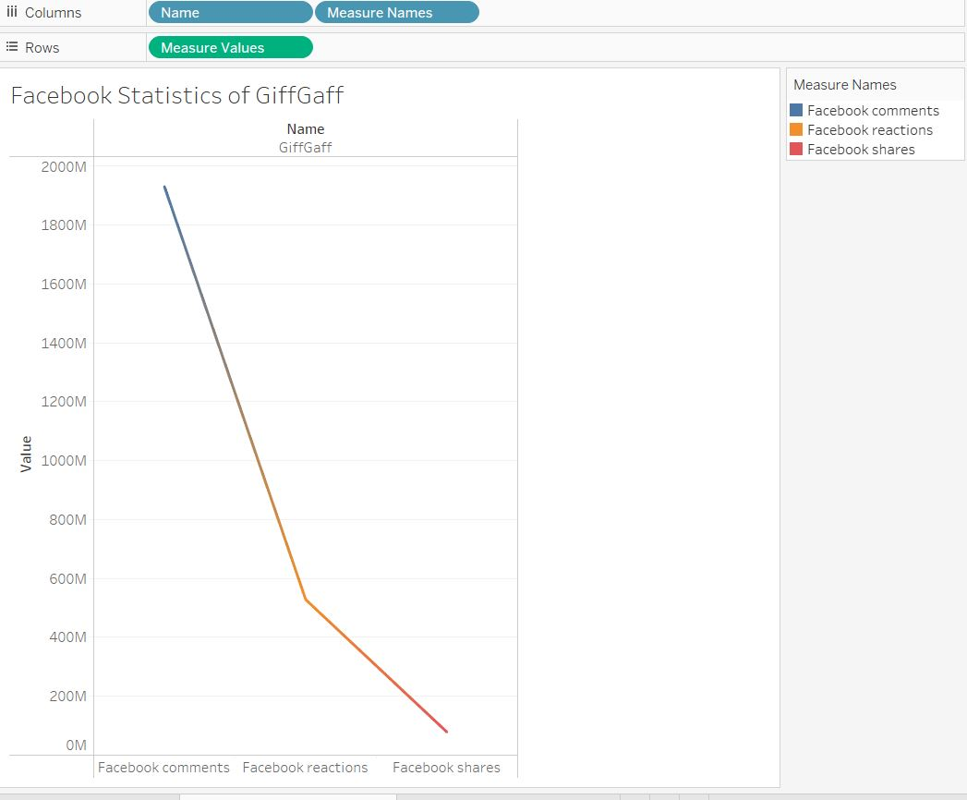
Visualisation of Facebook Statistics of GiffGaff

Slide 19
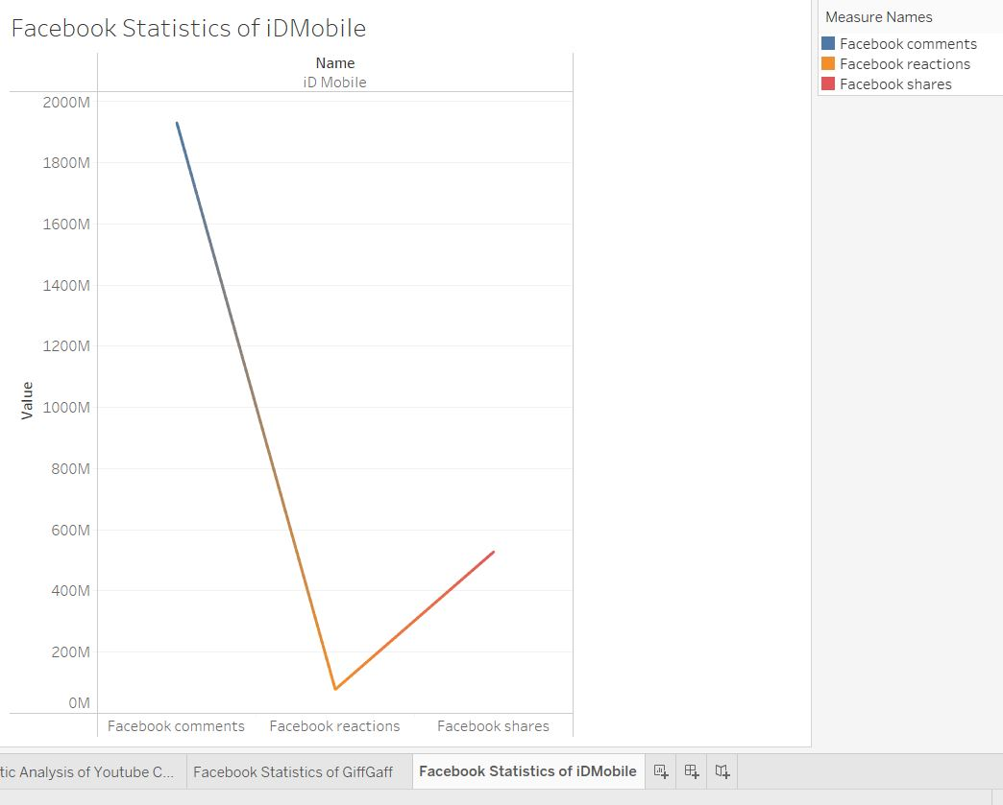
Visualisation of Facebook Statistics of iDMobile

Slide 20
Conclusion
Finally, the comparison of GiffGaff and iDMobile's social media analytics sheds important light on customer interaction, sentiment, and brand perception in the telecom industry. Both businesses may improve client experiences, hone their strategy, and keep a competitive edge in the ever changing digital market by utilizing data-driven tactics. Accepting these conclusions enables GiffGaff and iDMobile to make smarter adjustments, cultivate closer relationships with their users, and promote long-term success in the ever-changing social media space.

